Slide 1



Files, Directories, Exceptions
Working with the file system and handling exceptions
Files
SoftUni Team
Technical Trainers
Software University
http://softuni.bg

Slide 2

Table of Contents
File Operations
Directory Operations
What are Exceptions?
Handling Exceptions

Slide 3
Questions?
sli.do #Tech

Slide 4
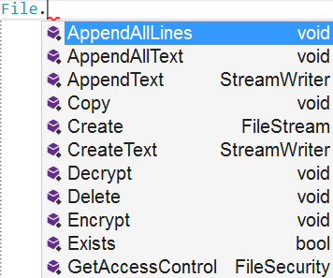
File Class in .NET
Easily Working With Files

Slide 5
Input Operations
ReadAllText() – reads everything at once and returns a string
ReadAllLines() – reads line by line and returns a collection
using System.IO;
…
string file = File.ReadAllText("file.txt");
using System.IO;
…
String[] file = File.ReadAllLines("file.txt");

Slide 6
Output Operations
WriteAllText() – takes a string and writes it to a file
WriteAllLines() – takes a collection and writes every element on a new line
There are also AppendAllText() and AppendAllLines() methods, that just add additional text to a file.
File.WriteAllText("output.txt", "Files are fun");
string[] names = {"pesho", "ivan", "stamat", "mariika"};
File.WriteAllLines("output.txt", names);

Slide 7
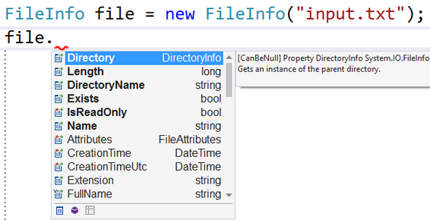
FileInfo Class
The FileInfo class provides you with properties that give you more information about a file.

Slide 8
Problem: Odd Lines
Write a program that reads a text file and writes its every odd line in another file. Line numbers starts from 0.
Two households, both alike in dignity, In fair Verona, where we lay our scene, From ancient grudge break to new mutiny, Where civil blood makes civil hands unclean. From forth the fatal loins of these two foes A pair of star-cross'd lovers take their life; Whose misadventured piteous overthrows Do with their death bury their parents' strife.
In fair Verona, where we lay our scene,
Where civil blood makes civil hands unclean.
A pair of star-cross’d lovers take their life;
Do with their death bury their parents’ strife
Check your solution here: https://judge.softuni.bg/Contests/Practice/Index/322#0

Slide 9
Solution: Odd Lines
string[] text = File.ReadAllLines("input.txt");
for (int i = 1; i < text.Length; i+=2)
{
File.AppendAllText("output.txt", text[i] + Environment.NewLine);
}
string[] text = File.ReadAllLines("input.txt");
File.WriteAllLines("output.txt",
text.Where((line, index) => index % 2 == 1));
Check your solution here: https://judge.softuni.bg/Contests/Practice/Index/322#0

Slide 10
Problem: Line Numbers
Write a program that reads a text file and inserts line numbers in front of each of its lines. The result should be written to another text file.
Two households, both alike in dignity, In fair Verona, where we lay our scene, From ancient grudge break to new mutiny, Where civil blood makes civil hands unclean.
1. Two households, both alike in dignity,
2. In fair Verona, where we lay our scene,
3. From ancient grudge break to new mutiny,
4. Where civil blood makes civil hands unclean.
Check your solution here: https://judge.softuni.bg/Contests/Practice/Index/322#1

Slide 11
Solution: Line Numbers
string[] text = File.ReadAllLines("input.txt");
for (int i = 1; i < text.Length; i+=2)
{
File.AppendAllText("output.txt",
$"{i + 1}. {text[i]}{Environment.NewLine}");
}
Check your solution here: https://judge.softuni.bg/Contests/Practice/Index/322#1

Slide 12
Problem: Word Count
Write a program that reads a list of words from the file words.txt and finds how many times each of the words is contained in another file text.txt. Matching should be case-insensitive. Write the results in file results.txt. Sort the words by frequency in descending order.
quick is fault
is - 3
quick - 2
fault - 1
-I was quick to judge him, but it wasn't his fault.
-Is this some kind of joke?! Is it?
-Quick, hide here…It is safer.
Check your solution here: https://judge.softuni.bg/Contests/Practice/Index/322#3

Slide 13
Solution: Word Count
string[] words = File.ReadAllText("words.txt").ToLower().Split();
string[] text = File.ReadAllText("input.txt").ToLower()
.Split(new char[] {'\n','\r',' ', '.', ',', '!', '?', '-'}, StringSplitOptions.RemoveEmptyEntries);
Dictionary<string, int> wordCount = new Dictionary<string, int>();
foreach (string word in words)
wordCount[word] = 0;
foreach (string word in text)
if (wordCount.ContainsKey(word))
wordCount[word]++;
// Save the Output to a file
Check your solution here: https://judge.softuni.bg/Contests/Practice/Index/322#3

Slide 14
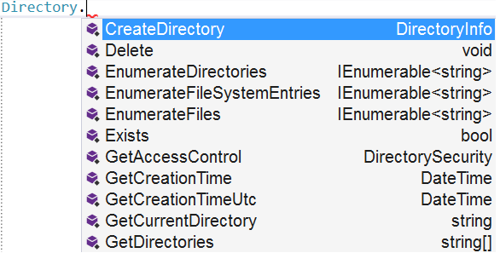
Directory Class in .NET
Easily Working With Directories

Slide 15
Basic Operations
CreateDirectory() – creates the directory and all subdirectories at the specified path, unless they already exist
Delete() – deletes an empty directory
Move() – moves a file or directory to a new location
Directory.CreateDirectory("Test");
Directory.Delete("Test");
Directory.Move("Test", "New Folder");

Slide 16
Basic Operations(2)
GetFiles() – returns the names of files (including their paths) in the specified directory
GetDirectories() – returns the names of subdirectories (including their paths) in the specified directory
string[] filesInDir = Directory.GetFiles("TestFolder");
string[] subDirs = Directory.GetDirectories("TestFolder");

Slide 17
Problem: Get Folder Size
You are given a folder named “TestFolder”. Get the size of all files in the folder, which are NOT directories. Print the result on the console in Megabytes.
Output
5.16173839569092
Check your solution here: https://judge.softuni.bg/Contests/Practice/Index/322#5

Slide 18
Solution: Get Folder Size
string[] files = Directory.GetFiles("TestFolder");
double sum = 0;
foreach (string file in files) {
FileInfo fileInfo = new FileInfo(file);
sum += fileInfo.Length;
}
int order = 0;
string[] sizes = { "B", "KB", "MB"};
sum = sum / 1024 / 1024;
File.WriteAllText("smth.txt", sum.ToString());
Check your solution here: https://judge.softuni.bg/Contests/Practice/Index/322#5

Slide 19

What are Exceptions?

Slide 20
What are Exceptions?
The exceptions in .NET Framework is a powerful mechanism for centralized handling of errors and unusual events
Simplify code construction and maintenance

Slide 21
The System.Exception Class
The System.Exception class is base for all exceptions in .NET
Contains information for the cause of the error / unusual situation
Message – text description of the exception
StackTrace – the snapshot of the stack at the moment of exception throwing

Slide 22
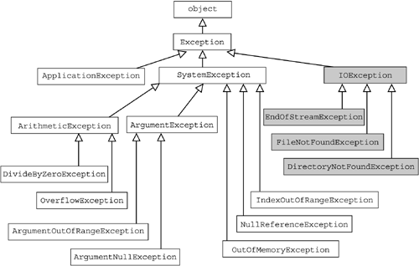
The Hierarchy of Exceptions

Slide 23

Handling Exceptions

Slide 24
The try-catch Statement
The statement:
try
{
// Do some work that can cause an exception
}
catch
{
// This block will execute if any type of exception occurs
}

Slide 25
The try-catch Statement(2)
try
{
// Do some work that can cause an exception
}
catch(FormatException formatException)
{
// This block will execute only if format exception occurs
}

Slide 26
The try-finally Statement
The statement:
Ensures execution of given block in all cases
When exception is raised or not in the try block
Used for execution of cleaning-up code, e.g. releasing resources
try
{
// Do some work that can cause an exception
}
finally
{
// This block will always execute
}

Slide 27
The try-catch-finally Statement
The statement:
try
{
// Do some work that can cause an exception
}
catch(FileNotFoundException fileNotFoundEx)
{
// This block will be executed only if file not found exception occurs
}
finally
{
// This block will always execute
}

Slide 28

Summary
You can use the File class to create/modify/delete files
You can use the Directory class to create/delete/iterate over directories
Exceptions provide a flexible error handling mechanism

Slide 29









Dictionaries, Lambda and LINQ
https://softuni.bg/courses/programming-fundamentals

Slide 30
License
This course (slides, examples, demos, videos, homework, etc.) is licensed under the "Creative Commons Attribution-NonCommercial-ShareAlike 4.0 International" license
Attribution: this work may contain portions from
"Fundamentals of Computer Programming with C#" book by Svetlin Nakov & Co. under CC-BY-SA license

Slide 31






Free Trainings @ Software University
Software University Foundation – softuni.org
Software University – High-Quality Education, Profession and Job for Software Developers
softuni.bg
Software University @ Facebook
facebook.com/SoftwareUniversity
Software University @ YouTube
youtube.com/SoftwareUniversity
Software University Forums – forum.softuni.bg

